Slide 1

Chapter 1: Atoms and elements

Slide 2
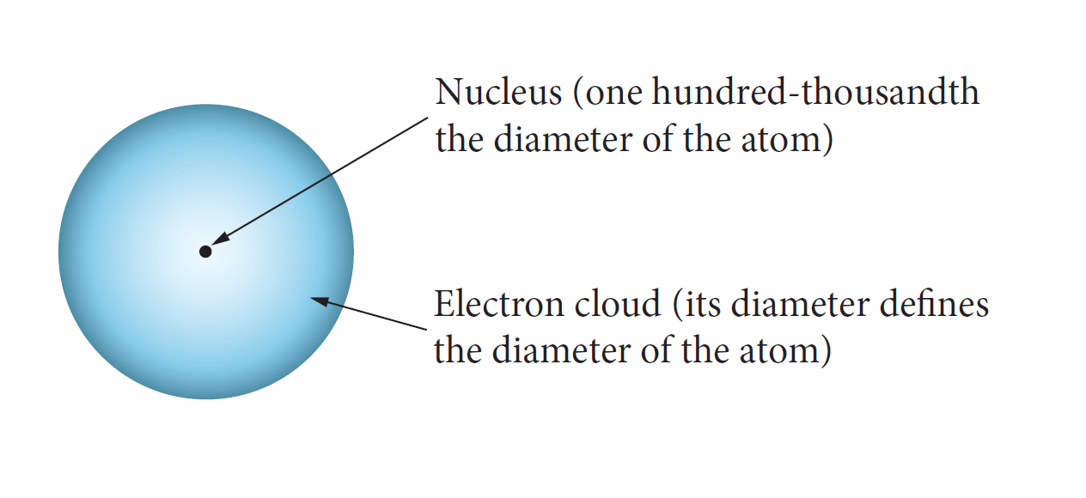
The atom
Subatomic:
proton, neutron, electron

Slide 3
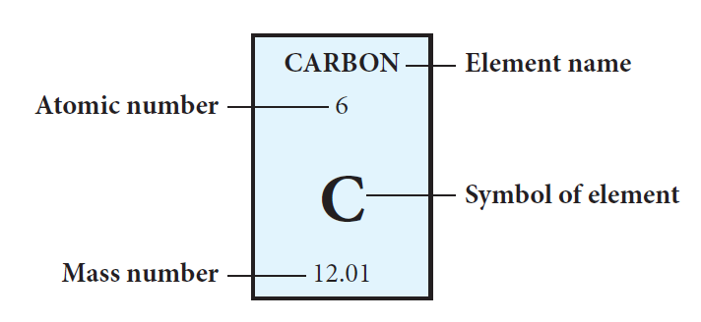
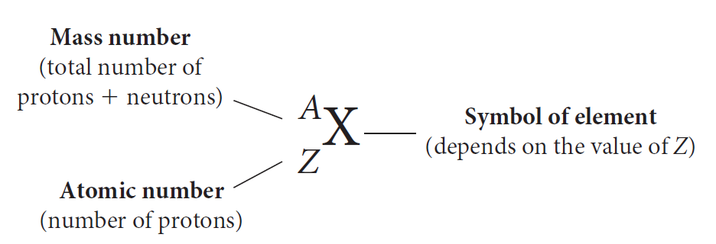
Atomic representation

Slide 4
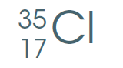
Worked example
Sodium
Chlorine
11 protons, 12 neutrons and 11 electrons
Atomic number = 11
Mass number = 23
So 23 – 11 = 12 neutrons
Number of electrons = 11
Atomic number = 17
Mass number = 35
So 35 – 17 = 18 neutrons
Number of electrons = 17

Slide 5
What holds an atom together?
An atom can be modelled as a nucleus
surrounded by electrons held together
by electrostatic forces of attraction
between the nucleus and electrons.

Slide 6
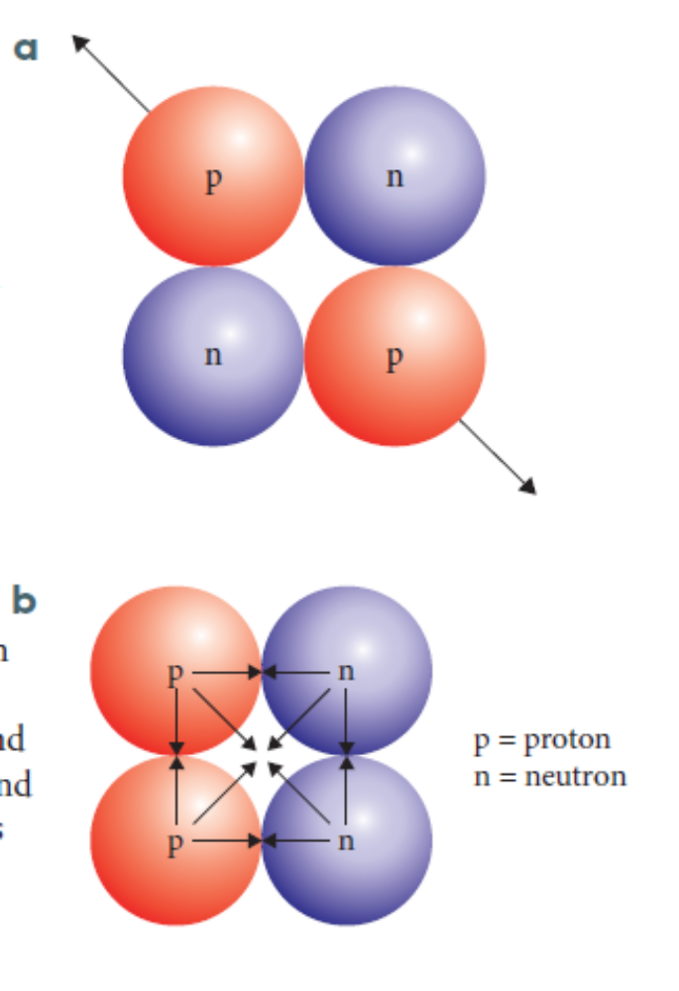
How a nucleus stays together
Electrostatic repulsion
  forces the protons apart
Strong nuclear force
  attracts the nuclear particles together
These forces balance?
yes = stable no = unstable

Slide 7
Isotopes
Different forms of the same element:
    same number of protons but different number of
    neutrons
    very similar chemical properties but different
    physical properties
        including nuclear stability and mass
When Electrostatic Repulsion > Nuclear Force
then you get radioactive decay.
Notes:
Isotopes are atoms of an element with the same number of protons but different number of neutrons.
Isotopes of the same element will have similar chemical properties but different physical properties including variations in nuclear stability.

Slide 8
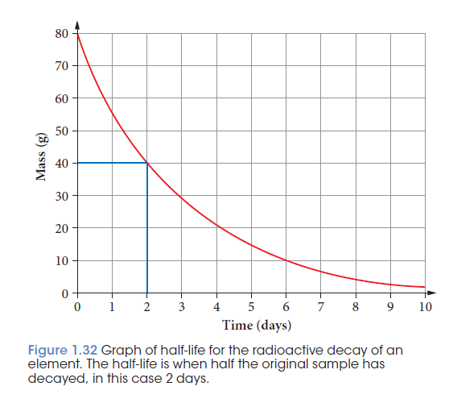
Half life of an isotope
Isotopes

Slide 9
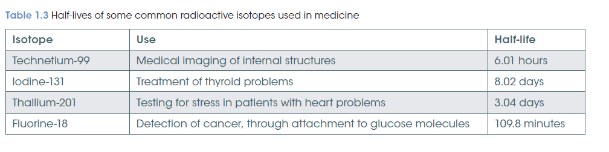
Medical uses of radioactive isotopes
Isotopes

Slide 10
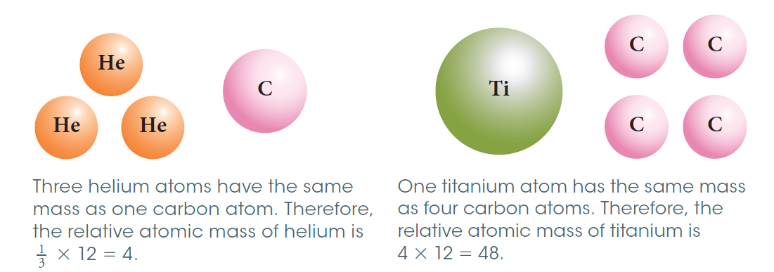
Relative atomic mass A_{r}
the ratio of the weighted average mass per atom of the naturally occurring form of the element to 1/12 the mass of an atom of carbon -12;
relative atomic masses reflect the isotopic composition of the element
Notes:
The relative atomic mass of an element is the ratio of the weighted average mass per atom on the naturally occurring form and reflects the isotopic composition of the element

Slide 11
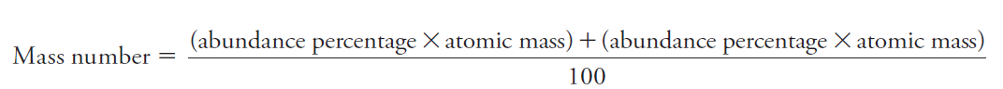
Calculating mass number for each element
Relative atomic mass A_{r}
Isotopes of the same element are found in different abundances on Earth
Each isotope has its own relative atomic mass

Slide 12
Worked example
Chlorine
Lithium
Lithium has two isotopes:
7.59 % Lithium 6
92.41% Lithium 7
Chlorine has two isotopes
75% chlorine 35
25% chlorine 37
(75 x 35) + (25 x 37)
100
= 35.5 %
(abundance percentage x atomic mass) + (abundance percentage x atomic mass)
100

Slide 13
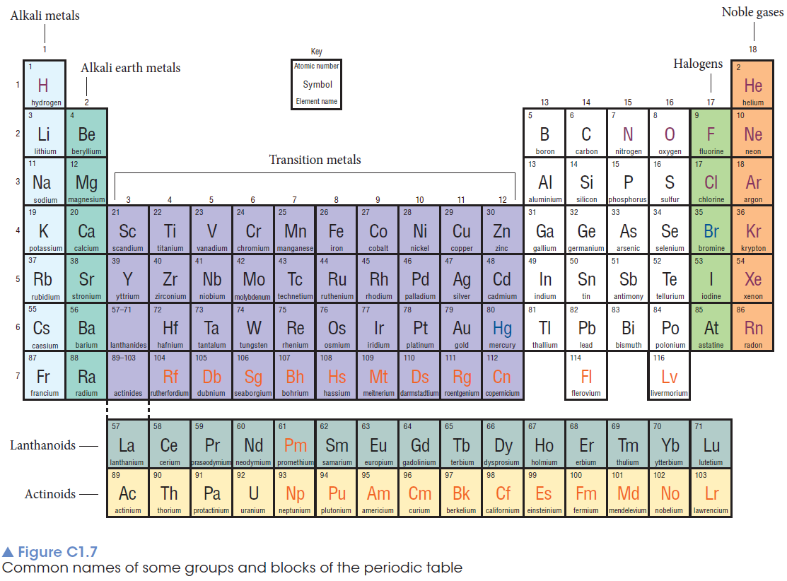
Periodic table

Slide 14
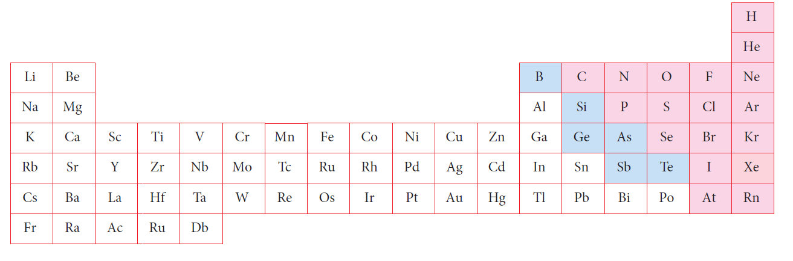
Trends in observable properties of elements are evident in periods and groups
Periodic table

Slide 15
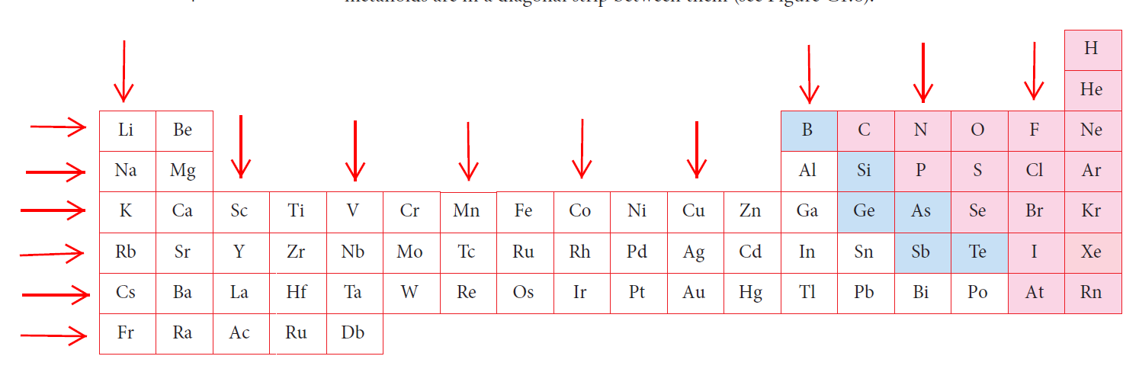
Groups have similar properties!
Group each column
numbered 1-18
Period each row
numbered 1-7
Metals white
Non metals pink
Metalloids blue

Slide 16
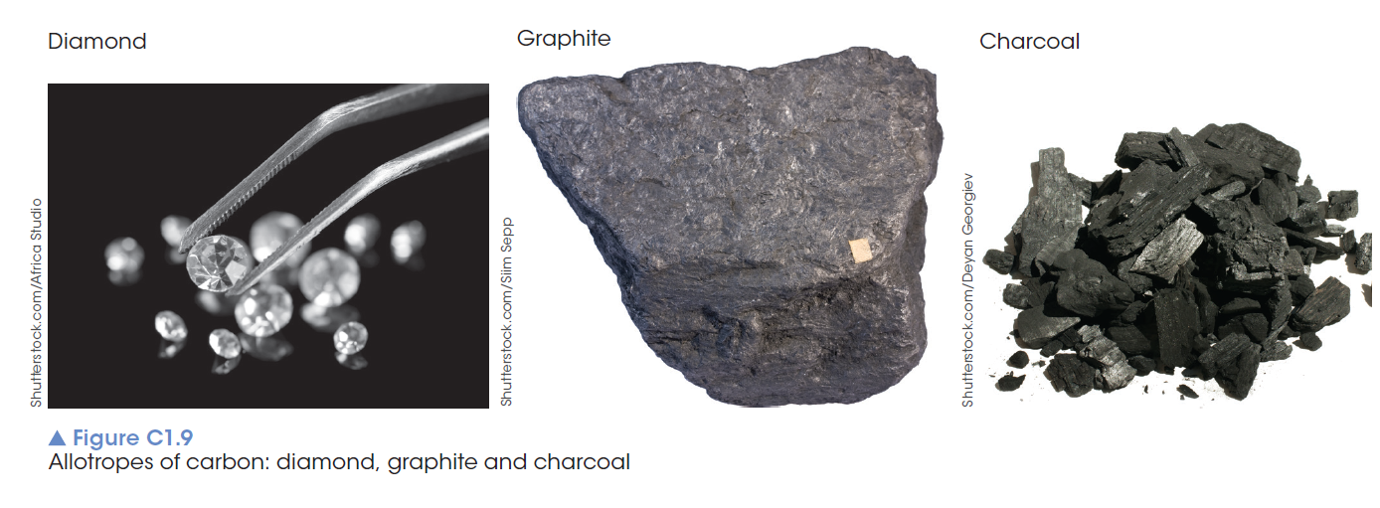
Elemental carbon exists as several allotropes elemental carbon
Elemental carbon

Slide 17
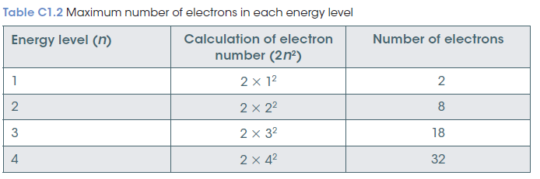
Electron arrangement
Is used to predict chemical reactivity
Electrons exist in particular energy levels or shells
Each shell - holds a specific number of electrons 2n²

Slide 18
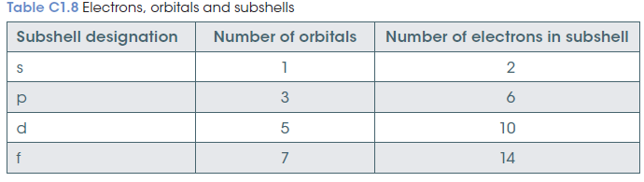
Subshells: electron configuration
Each energy level has subshells: s,p,d,f
Each subshell has a region of space called atomic orbitals: each can hold 0,1, 2 electrons

Slide 19
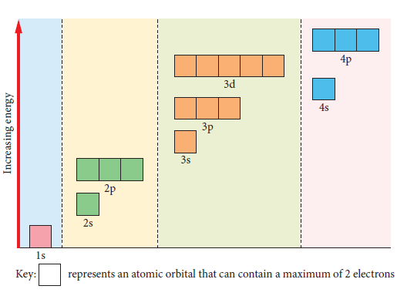
Orbitals
Filling order; lowest energy filled first

Slide 20
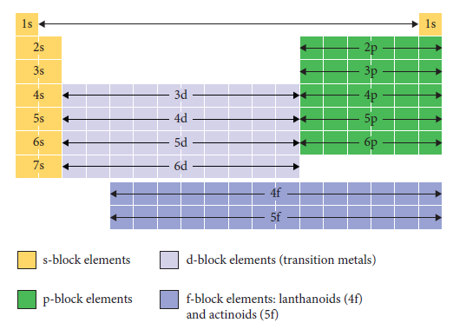
Orbitals
Relation to periodic table

Slide 21
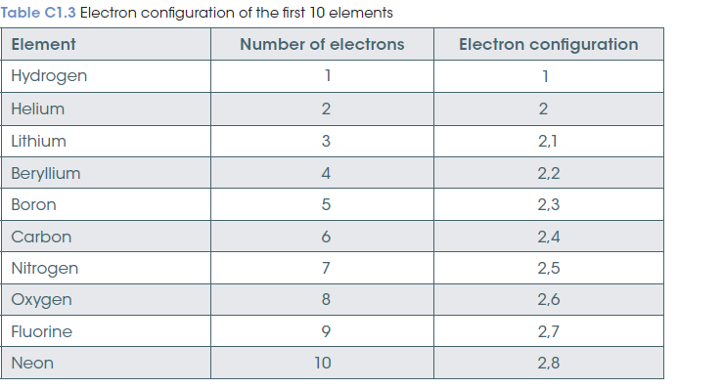
Electronic configuration
  Using shells
Notes:
http://www.pbslearningmedia.org/resource/lsps07.sci.phys.matter.graphperiodic/graphing-the-periodic-table/

Slide 22
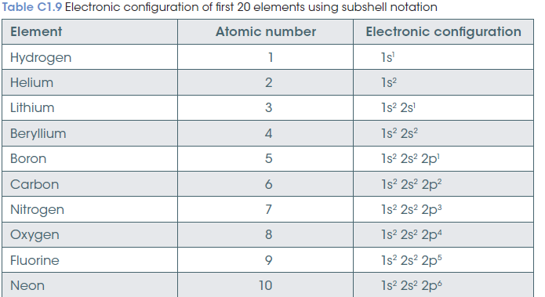
Electronic configuration
  Using orbitals
Notes:
http://www.pbslearningmedia.org/resource/lsps07.sci.phys.matter.graphperiodic/graphing-the-periodic-table/

Slide 23
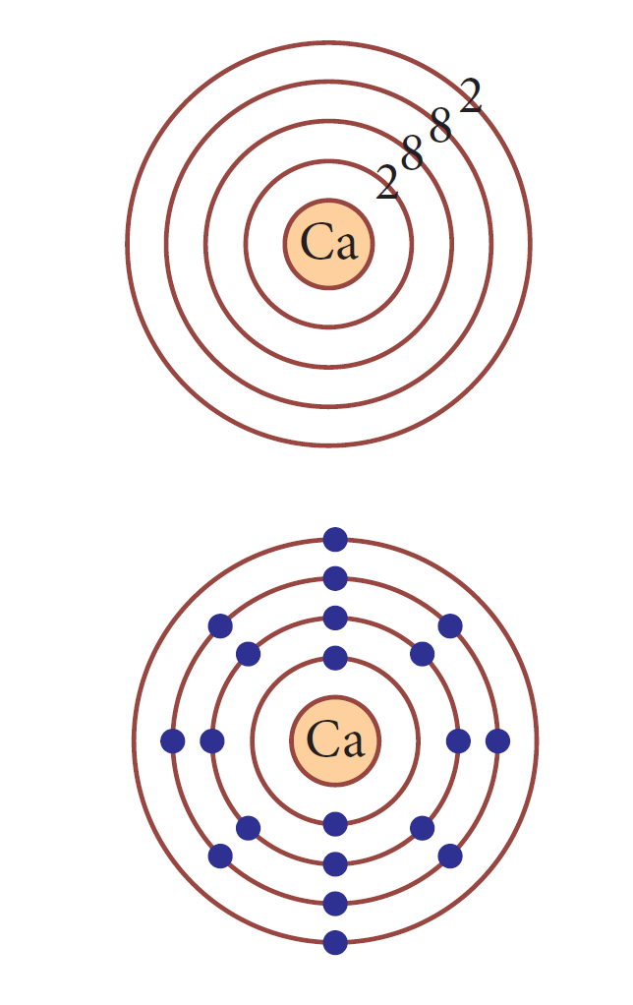
Representing electrons
Electron shell diagrams
Electrons exist in distinct energy levels, which can be represented by electron shell diagrams

Slide 24
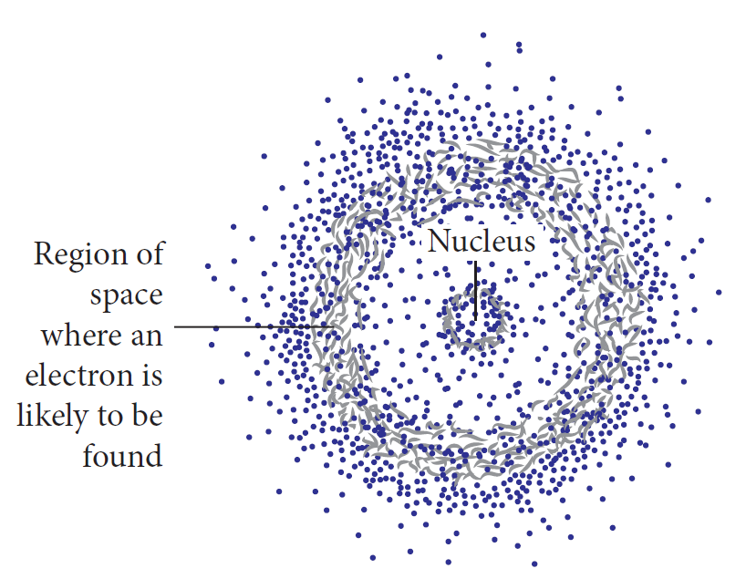
Representing electrons
Electron charge cloud diagrams
Electrons exist in distinct energy levels, which can be represented by electron charge clouds

Slide 25
Valence shell electrons
The outer shell of electrons
Which can be determined from the periodic table:
For groups 1 – 2 - it corresponds to the group number
For groups 13 – 18 - it corresponds to the group number – 10.
Groups 3 – 12 don’t follow this pattern (transitions metals)

Slide 26
Periodic table trends
The structure of the periodic table is based upon the electron configuration of atoms and shows trends in properties
These properties are:
Atomic radius
Ionisation energy
Electronegativity
Electron affinity
Metallic nature

Slide 27
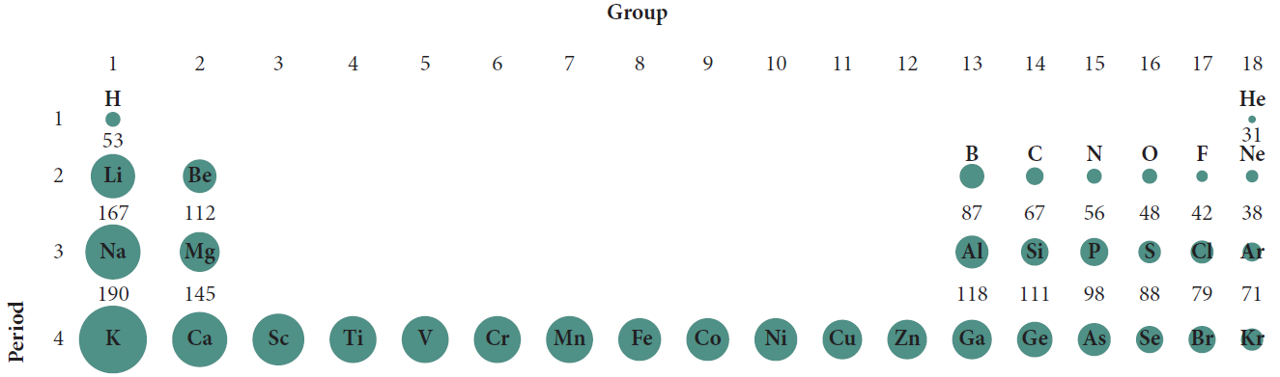
Atomic radius
Distance from the nucleus to the boundary of the outer electrons
Decreases across a period: electrons closer to nucleus
Increases down a group: more energy levels results

Slide 28
Ionisation energy
The amount of energy need to remove an electron from a neutral atom when it is a gas.
Increases across a period : as the number of protons increase, the attraction to the electrons also increases so ____energy is required to remove the electrons.
Decreases down a group: more energy levels- electrons further from the nucleus so ___ energy needed to remove the electrons.

Slide 29
Electronegativity
The ability of an atom to form bonds with an electron
Increases across a period – nucleus more positive so attracts the electrons more.
Decreases down a group – more energy levels so attraction between electrons and the nucleus is less.
Noble gases have no electronegativity as they have full shells.

Slide 30
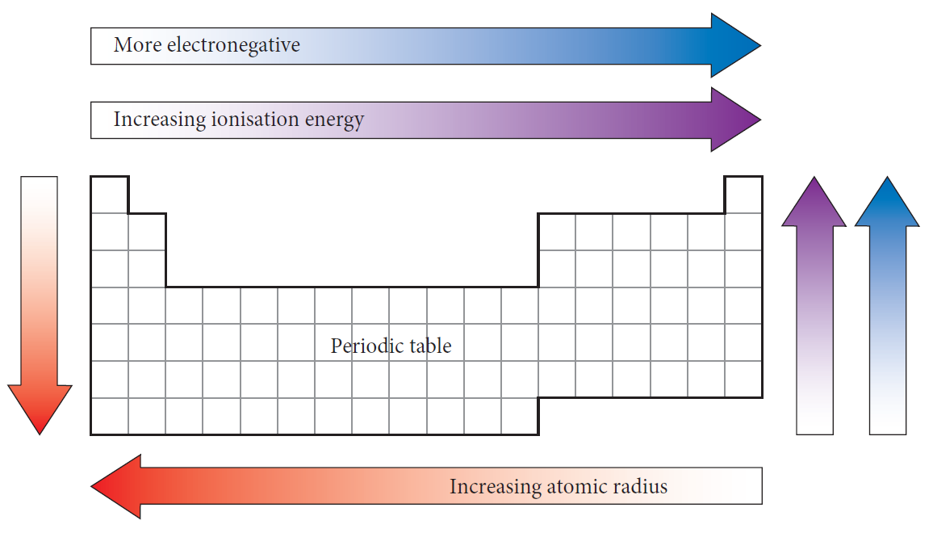
Trends summarised

Slide 31
Two more trends
Electron affinity
Metallic character
The ability of an atom in the gas state to accept an electron and form a negative ion.
Increases across a period
Decreases down a group
Describes the set of properties associated with metals
Depends upon the ability to lose their valence electrons
Decreases across a period
Increases down a group

Slide 32
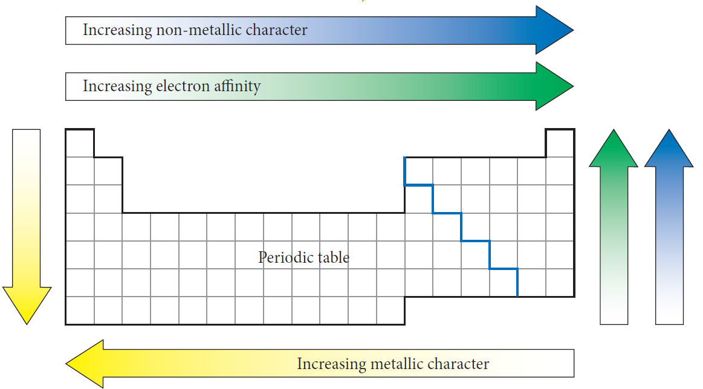
Trends summarised

Slide 33
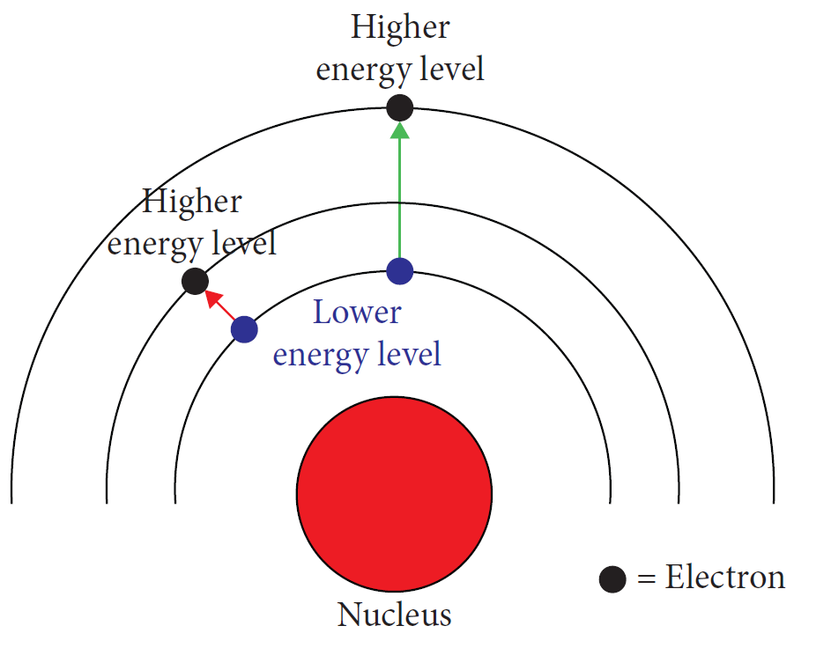
Elemental spectra
When all the electrons are in
the lowest levels
The atom is in the ground state

Slide 34
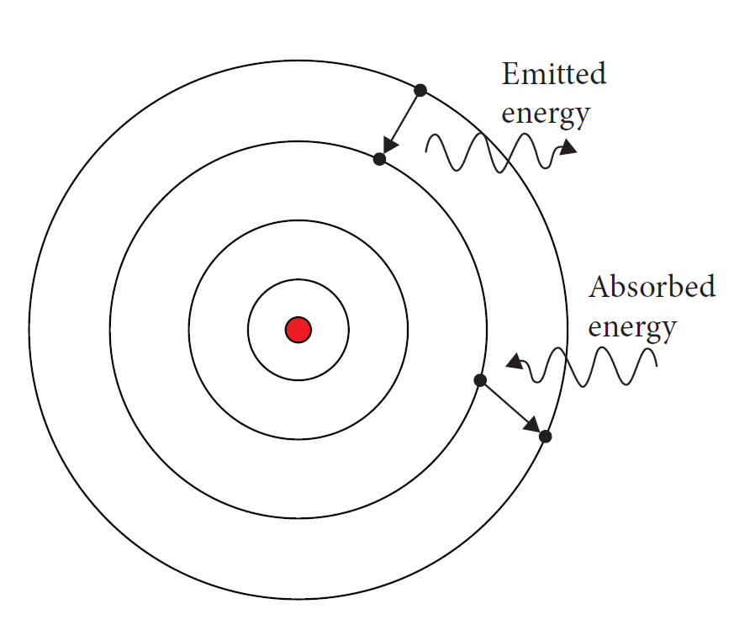
Movement of electrons
Electrons can gain energy to move to a higher energy state.
The atom is now in an excited state.
When the electron loses this energy, as light, it drops to a lower energy level.
This difference relates to the wavelength of light.

Slide 35
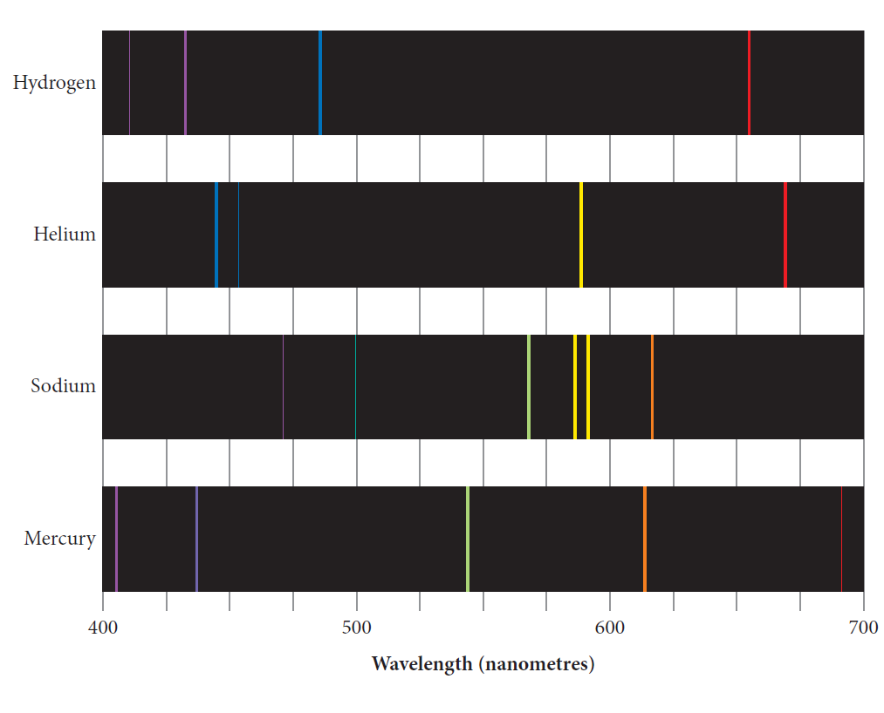
Emission spectroscopy
Spectroscopy is used to
identify elements
based upon their unique set of energy levels
elements will emit light with a unique set of wavelengths
the pattern for one element is always the same.

Slide 36
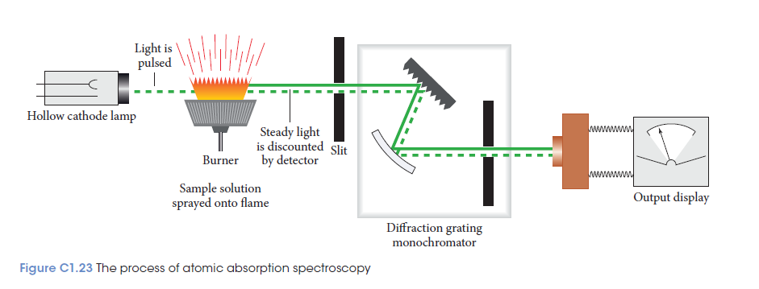
Atomic absorption spectroscopy
Quantitative analysis

Slide 37
Atomic absorption spectroscopy
Relies on electron transfer between atomic energy levels and can be used to identify the metal elements.

Slide 38
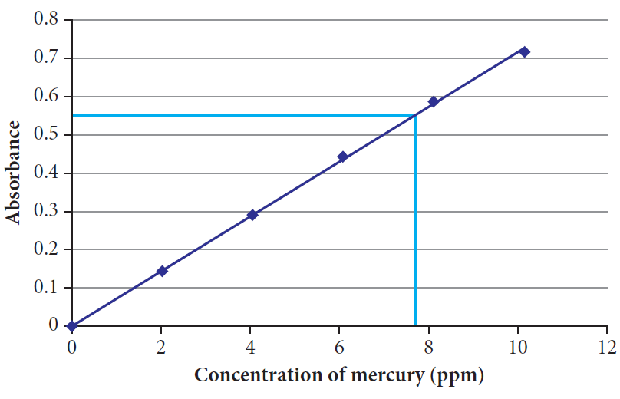
Atomic absorption spectroscopy
By using interpolation on this graph,
you can determine the concentration
of the unknown sample.
Requires a calibration curve

Slide 39
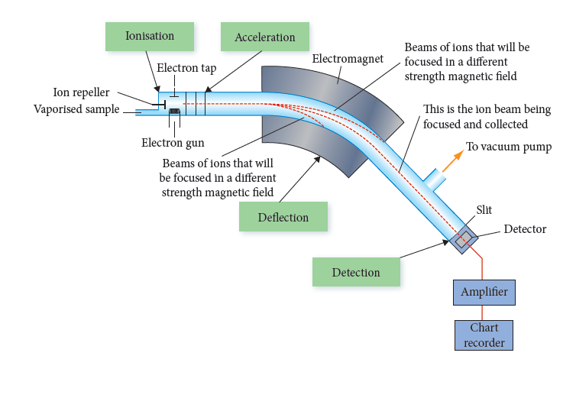
Mass spectrometry
Determines the mass and relative
abundance of each isotope
Electrons are used to knock off electrons forming ions
The ions are deflected and then detected.
Heavier ions are deflected less
Produces a mass spectrum

Slide 40
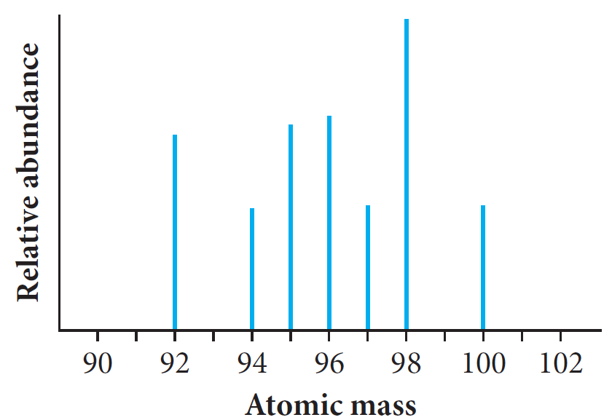
Mass spectra used to determine the abundance and mass of isotopes
Mass spectrometry

Slide 41
Worked example
Determine the number of isotopes and their relative atomic masses.
Which isotope is present in the highest concentration?
Which isotopes are present in equal amounts?
Count the number of peaks & read off the atomic masses
The isotope with the highest peak in the spectrum
Equal amounts = peaks at the same height

